Slide 1
Chapter 6 -Data Analytics for IoE
Dr. Vinayak A Bharadi

Slide 2
Contents
Introduction,
Apache Hadoop,
Using Hadoop MapReduce for Batch Data Analysis
Apache Oozie , Apache Spark, Apache Storm,
Using Apache Storm for Real-time Data Analysis,
Structural Health Monitoring-Case Study,
Tools for IoT:-
Chef, Chef-Case Studies,
Puppet, Puppet Case Study
Multi-tier Deployment,
NETCONF-YANG Case Studies,
IoT Code Generator.

Slide 3
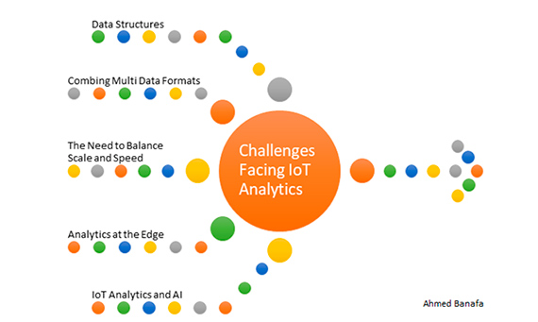

Slide 4
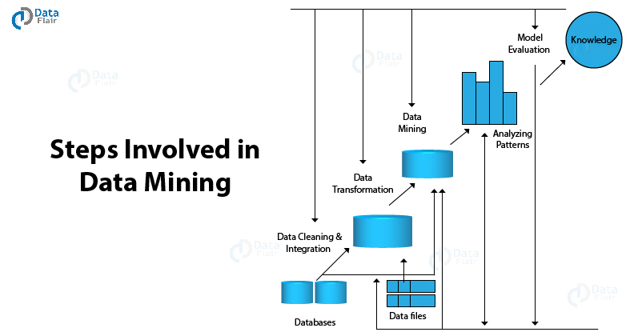

Slide 5
